Slide 1

EXCEL FORMULA CHALLENGE
What's hiding inside your spreadsheet that a formula could find in seconds?
A guided walkthrough of real formula challenges - SUMIFS, XLOOKUP, COUNTIFS, MAXIFS, AVERAGEIFS, IFS and a full Pivot Table dashboard solved and documented step by step.

Slide 2
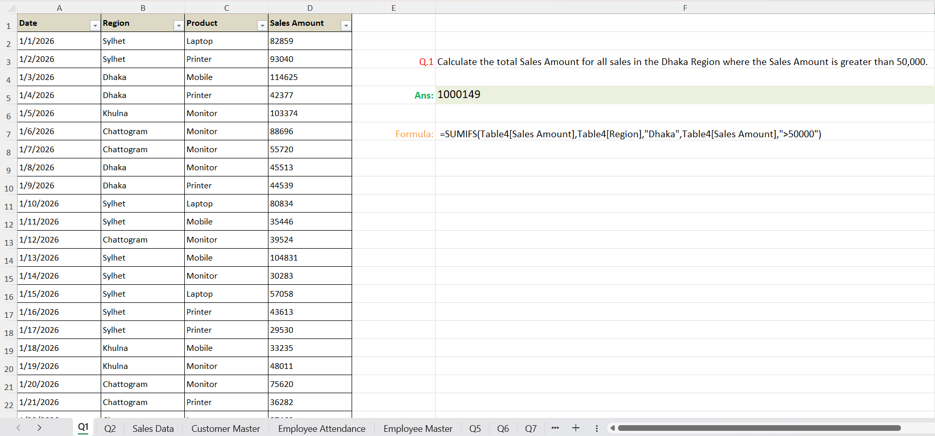
Q1
SUMIFS - Conditional Total by Region & Threshold
Solution: SUMIFS adds every Sales Amount where Region is “Dhaka” and the amount exceeds 50,000, returning a total of 1,000,149.

Slide 3
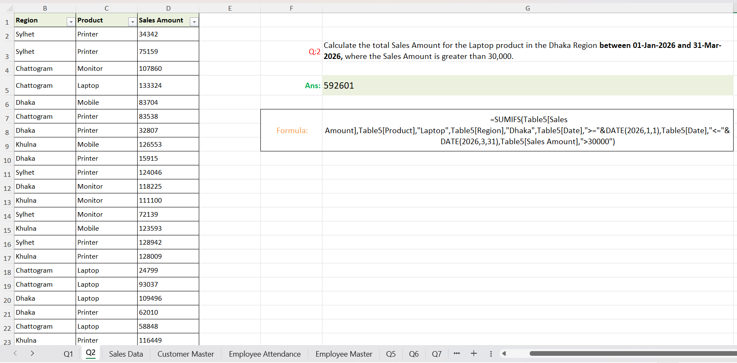
Q2
SUMIFS - Multi-Condition Sum with Date Range
Solution: SUMIFS layers four conditions - Product, Region, a Jan-Mar 2026 date window, and a 30,000 minimum to reach 592,601.

Slide 4
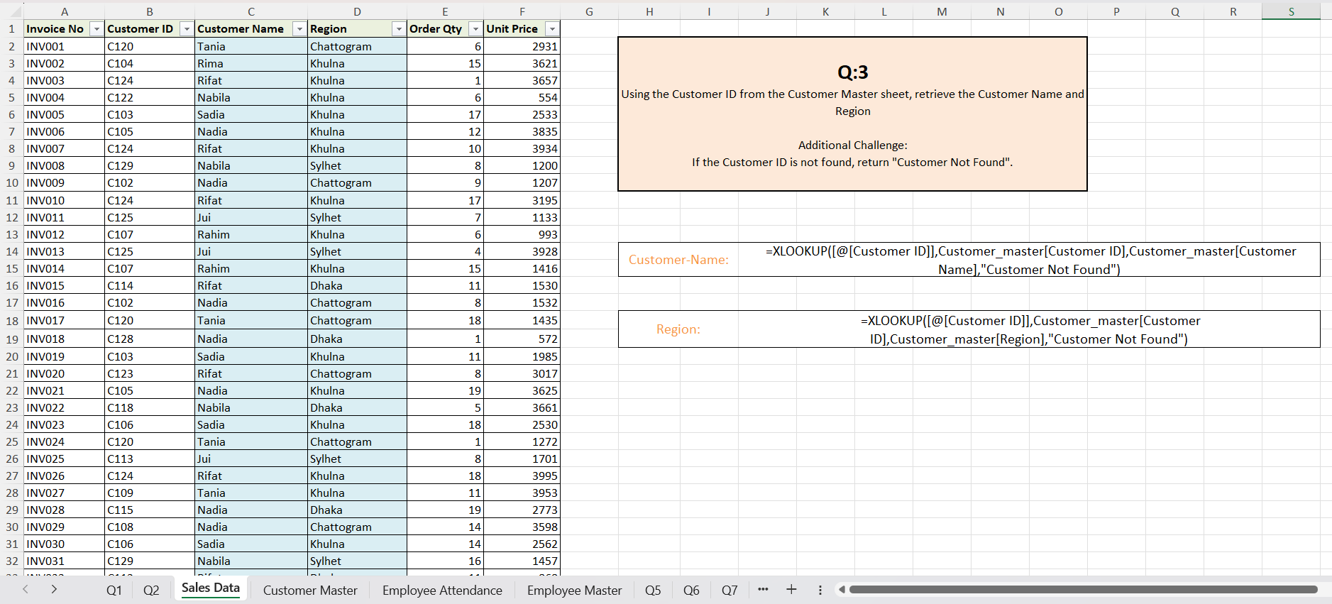
Q3
XLOOKUP - Pulling Customer Name & Region
Solution: XLOOKUP matches each Customer ID against the Customer Master sheet to fetch the Name and Region, showing “Customer Not Found” for any unmatched ID.

Slide 5
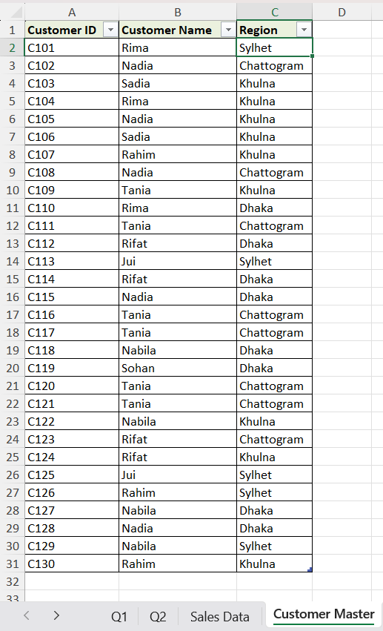
Reference Table - Customer Master
The lookup source: A clean table pairing every Customer ID with its Customer Name and Region, used by the XLOOKUP formulas on the Sales Data sheet.

Slide 6
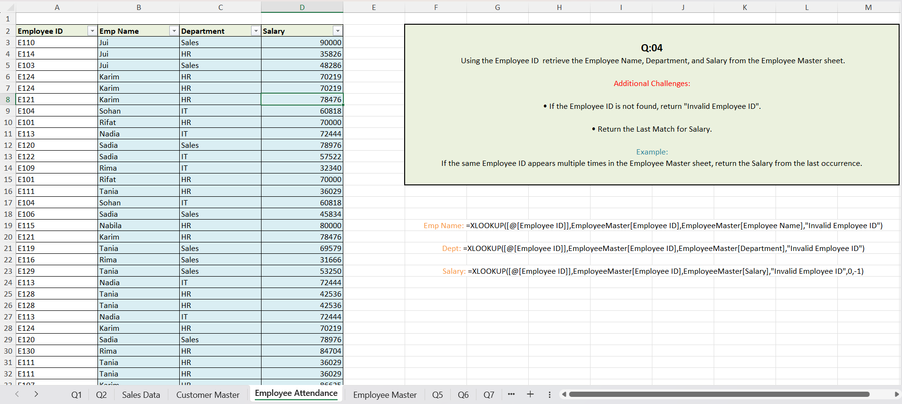
Q4
XLOOKUP - Employee Lookup with Last-Match Logic
Solution: XLOOKUP retrieves Name, Department, and Salary by Employee ID; the Salary lookup uses search mode -1 so a repeated ID returns its last occurrence, with “Invalid Employee ID” as the fallback.

Slide 7
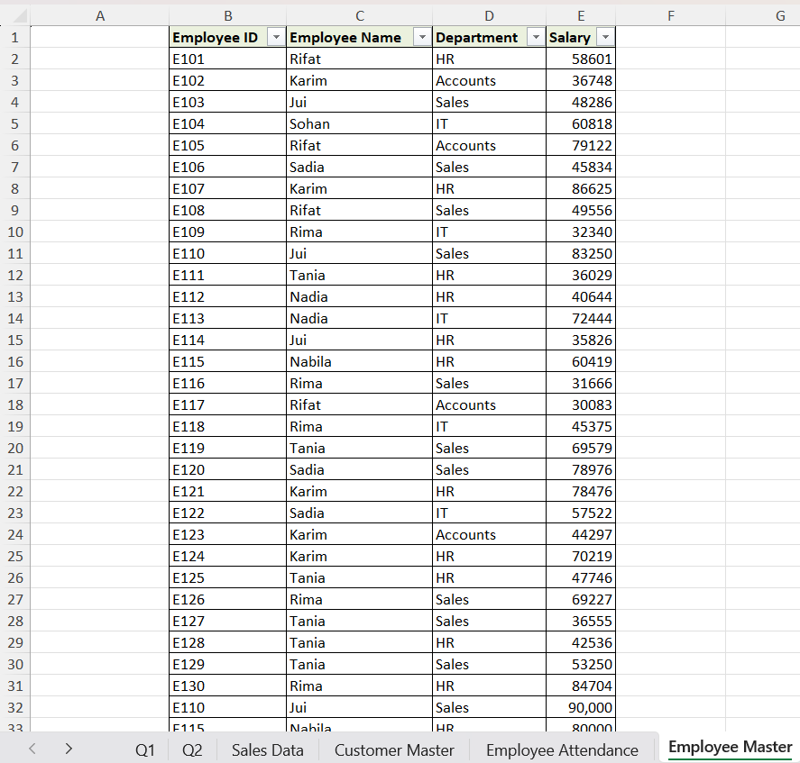
Reference Table - Employee Master
The master employee list: including intentionally duplicated Employee IDs that the lookup formulas search against.

Slide 8
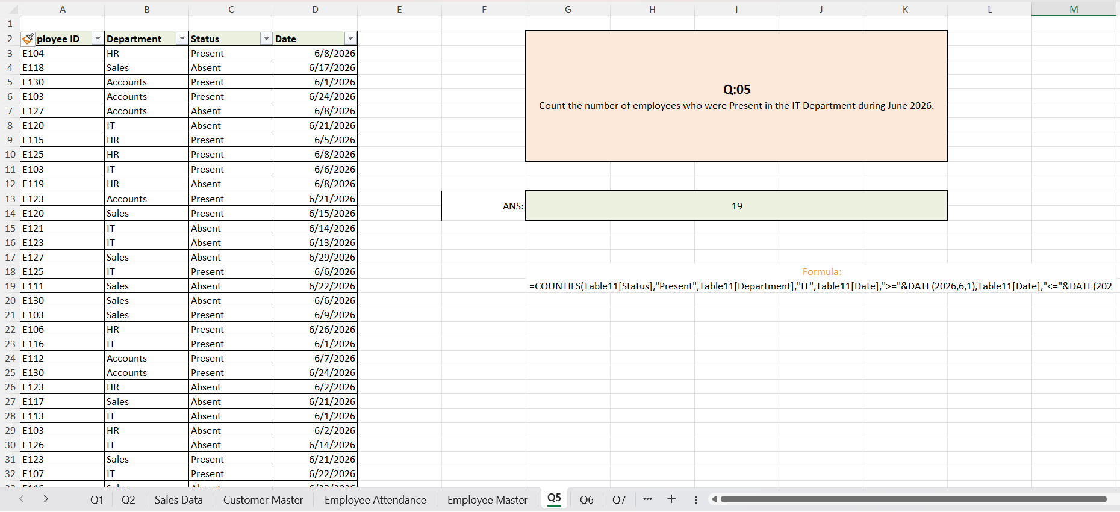
Q5
COUNTIFS - Attendance Count by Month & Department
Solution: COUNTIFS counts rows where Status is “Present,” Department is “IT,” and the Date falls within June 2026, giving a result of 19.

Slide 9
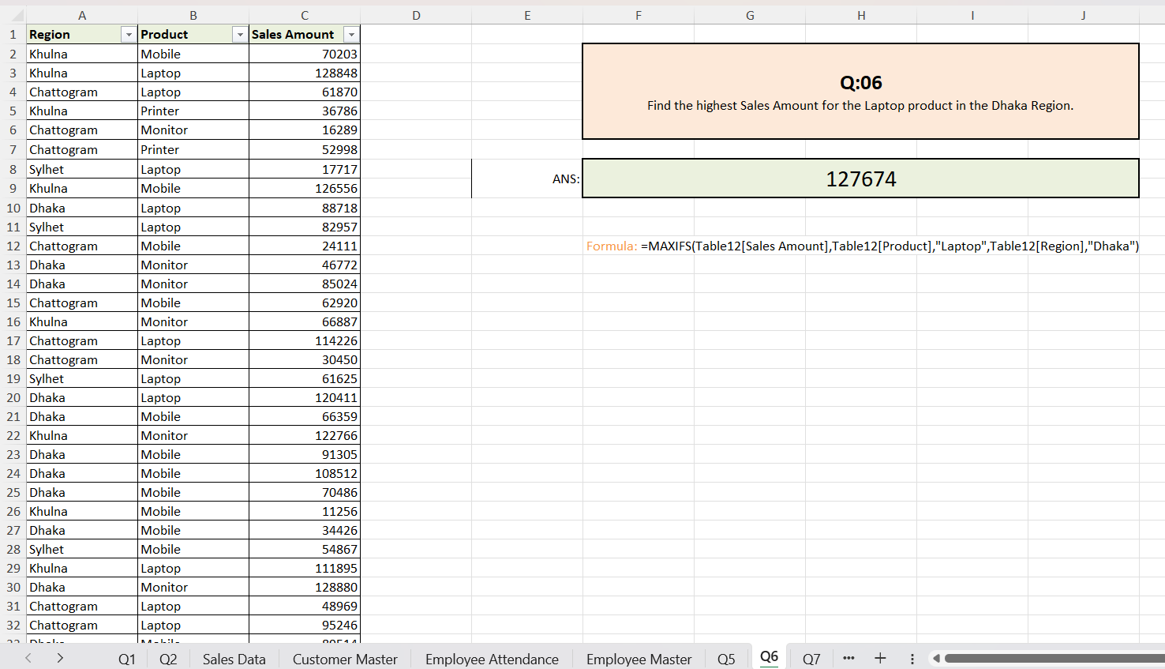
Q6
MAXIFS - Highest Sale Under Two Conditions
Solution: MAXIFS scans all Laptop sales in the Dhaka region and returns the single highest amount: 127,674.

Slide 10
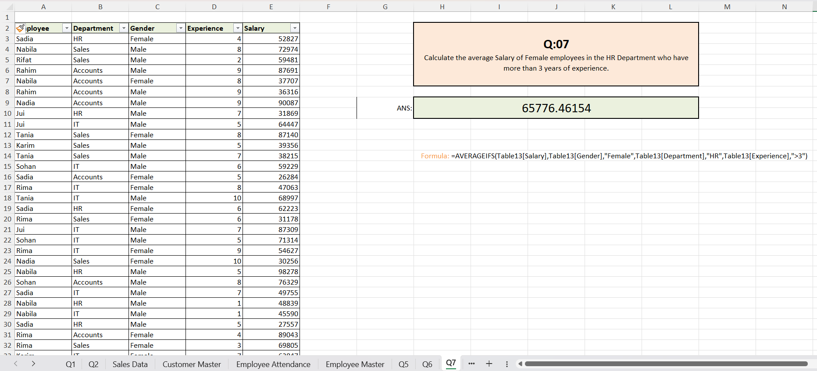
Q7
AVERAGEIFS — Average Salary by Gender, Dept & Tenure
Solution: AVERAGEIFS averages Salary for Female employees in the HR Department with more than 3 years of Experience, landing on 65,776.46.

Slide 11
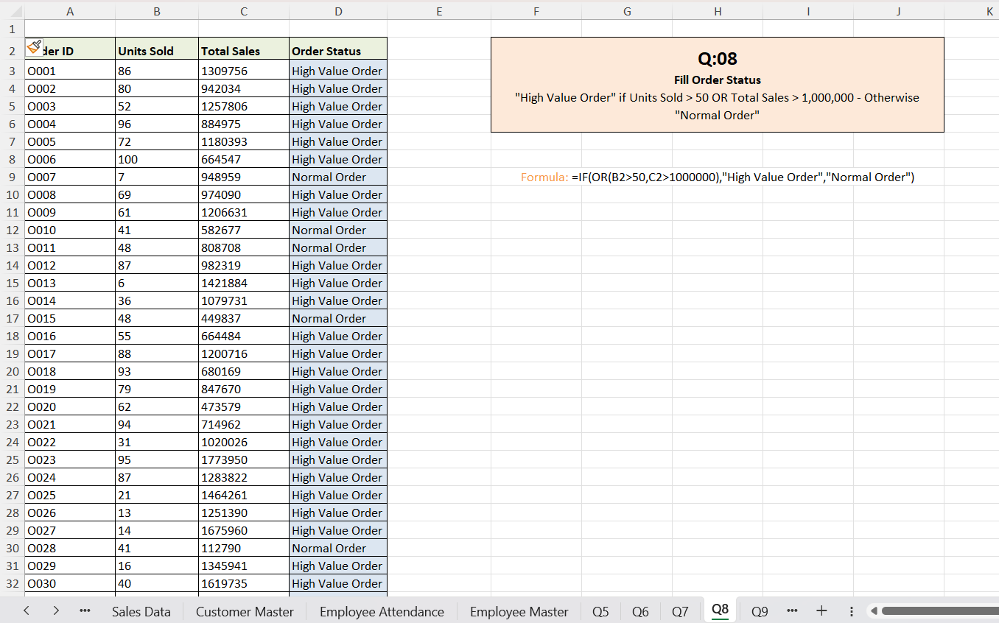
Q8
IF + OR - Flagging High-Value Orders
Solution: A nested IF/OR marks an order “High Value Order” when Units Sold exceed 50 or Total Sales exceed 1,000,000, otherwise labels it “Normal Order.”

Slide 12
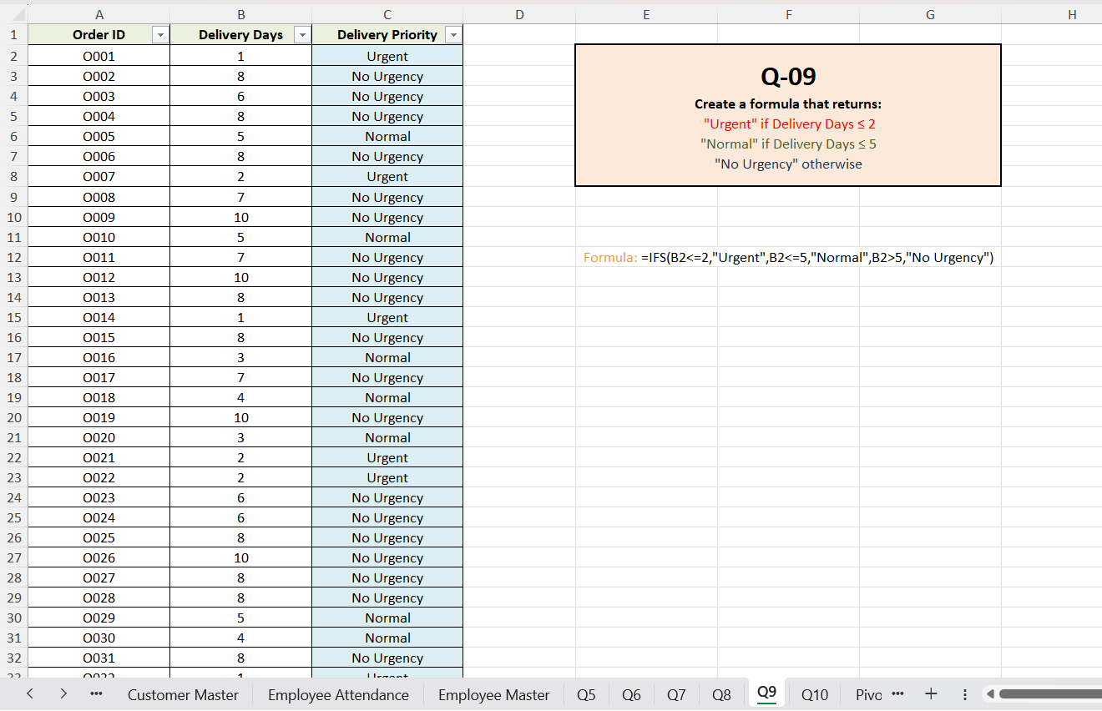
Q9
IFS - Tiered Delivery Priority
Solution: IFS checks Delivery Days in order - ≤ 2 is “Urgent,” ≤ 5 is “Normal,” otherwise “No Urgency” to classify every order automatically.

Slide 13
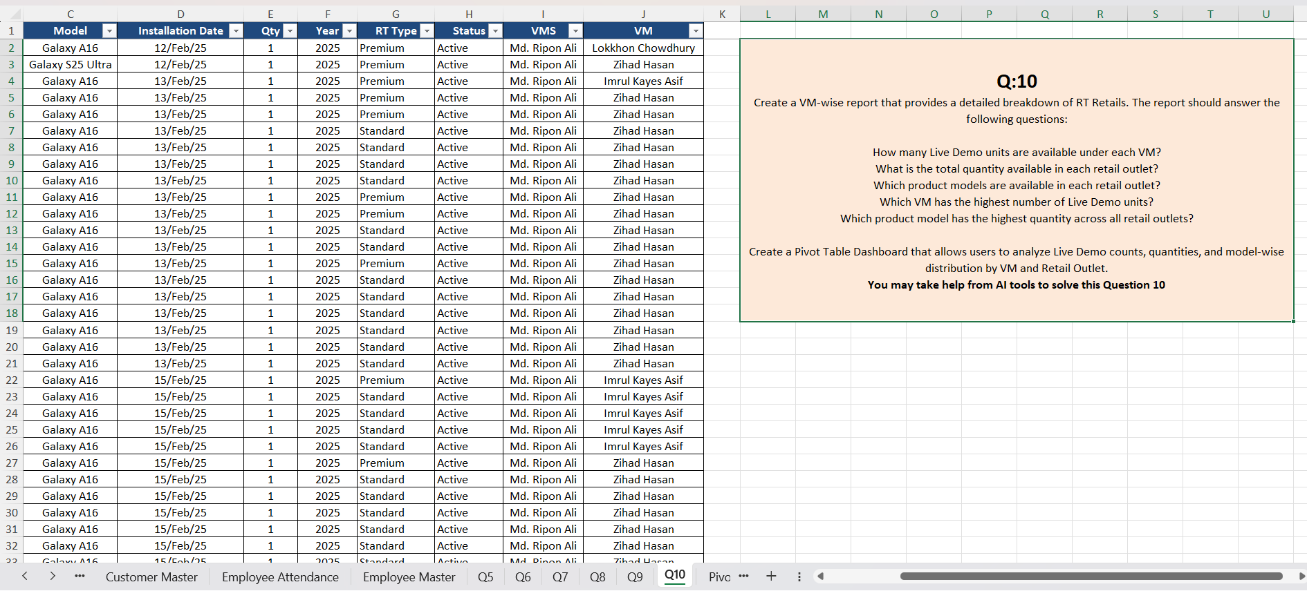
Q10
Project Brief - VM-Wise Pivot Dashboard
The task: Build a VM-wise breakdown of RT Retails covering Live Demo counts, outlet quantities, model availability, and the top-performing VM and model - delivered as an interactive Pivot Table dashboard.

Slide 14
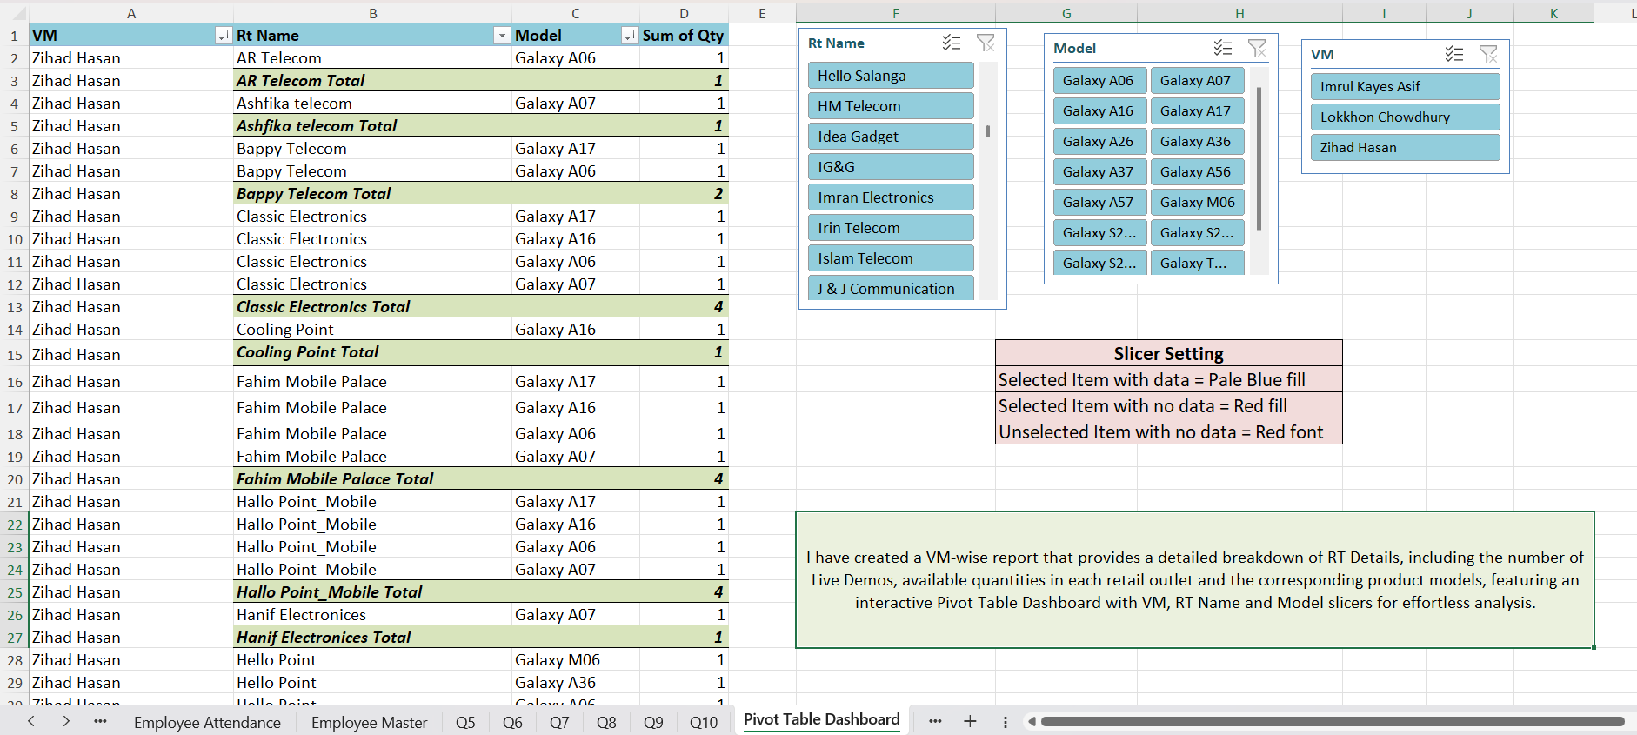
Q11
Pivot Dashboard - Detail View by VM & Outlet
Solution: The Pivot Table lists every RT outlet and Model under each VM along with its Sum of Qty, giving a full row-level breakdown before any slicer is applied.

Slide 15
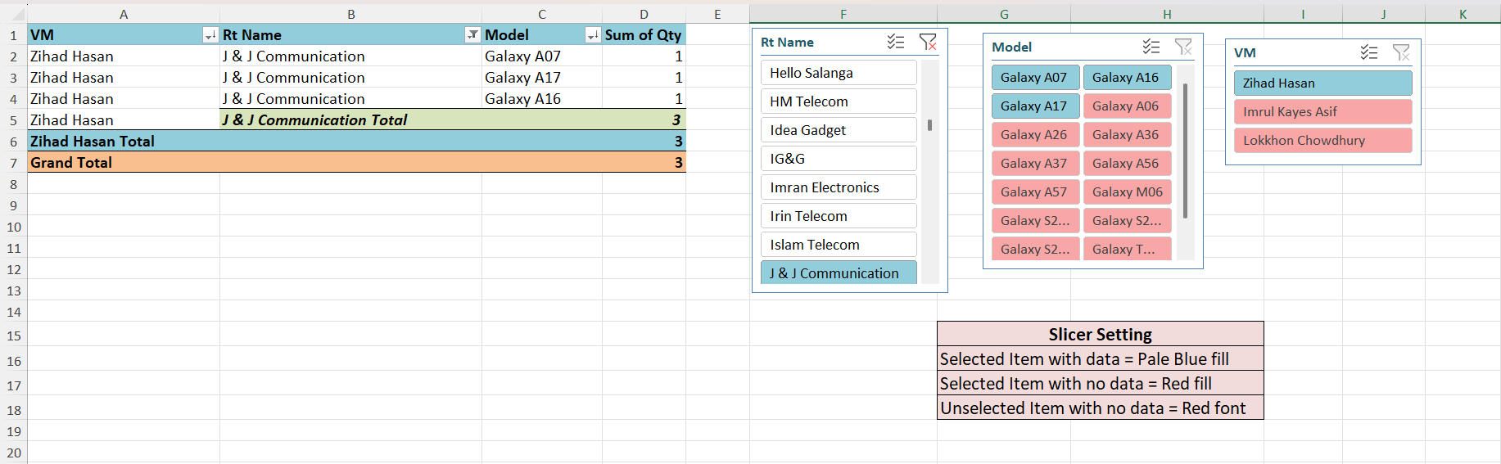
Q12
Pivot Dashboard - Filtered by Retail Outlet
Solution: Selecting “J & J Communication” in the RT Name slicer isolates its 3-unit total under Zihad Hasan, with unrelated outlets grayed out.

Slide 16
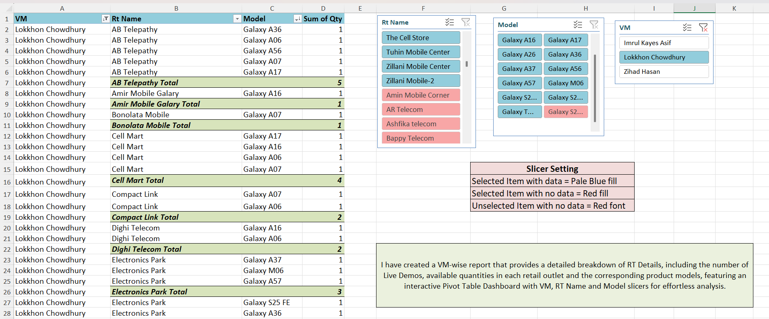
Q13
Pivot Dashboard - Detail View for Lokkhon Chowdhury
Solution: Expanding VM “Lokkhon Chowdhury” breaks down quantity by every retail outlet and model, the same interactive pattern applied per VM.

